Slide 1

Unit 6 – Lesson 3
In the classroom
Notes:
Goals: By the end of the lesson, pupils will be able to:
listen and repeat the sentence It’s a red pen.
introduce the things, using It’s a red _____.
sing a song focusing on the main structures I have _____ ; He has _____ and It’s a red _____.

Slide 2

Warm-up
Notes:
Goal: Review the chant of Lesson 2.
Time limit: 5 mins.
- Pupils say the chant together.
- Teacher sticks flashcards of pen, pencil, desk, bell on the board.
- Teacher says e – e – bell following the chant rhythm. Pupils repeat.
- Individual check: Teacher points to a picture, Pupils say the words with the chant rhythm.
- Faster student gets more stars for their team.

Slide 3


Listen and repeat
Notes:
Goal:
- Pupils will be able to listen and repeat the sentence It’s a red pen.
Step 1: Getting to know the structure It’s a red ______
- Teacher shows picture of a red pen on slide. Teacher asks What’s it? Teacher has pupils say It’s a pen.
- Teacher asks What colour is it? . Teacher has pupils say It’s red.
- Teacher has whole class say It’s a red pen.
- Teacher does the same with pencil, bell, desk.
Step 2: Pupils listen and repeat.
Time limit: 2 mins
- Pupils open to the Listen and repeat part in their books.
- Teacher plays the audio, pupils listen and repeat.
Step 3: Quick check.
Time limit: 4 mins
- Quick check as teams: Teacher holds up flashcard pen and says Team 1. Pupils of team 1 says It’s a red pen. Teacher does the same with the other teams.
- Teacher does the same for individual check.

Slide 4
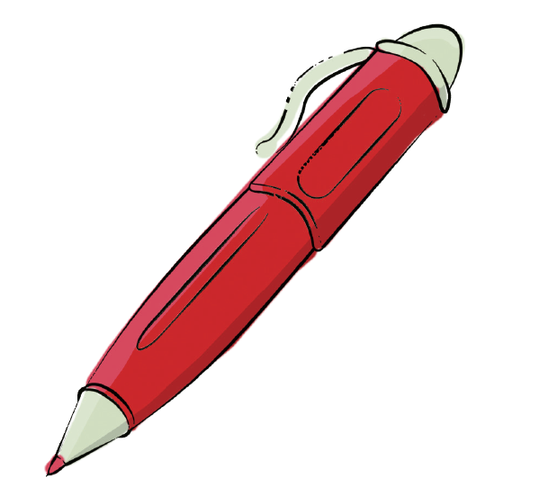
It’s a red pen.

Slide 5
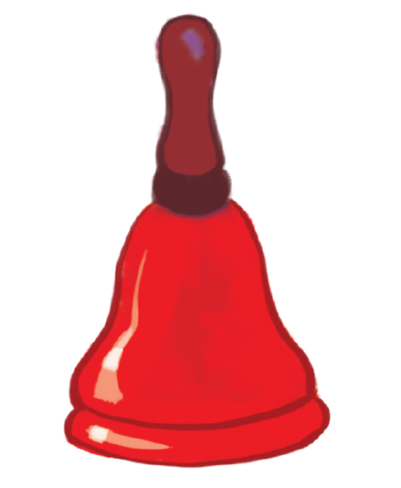
It’s a red bell.

Slide 6

It’s a red pencil.

Slide 7
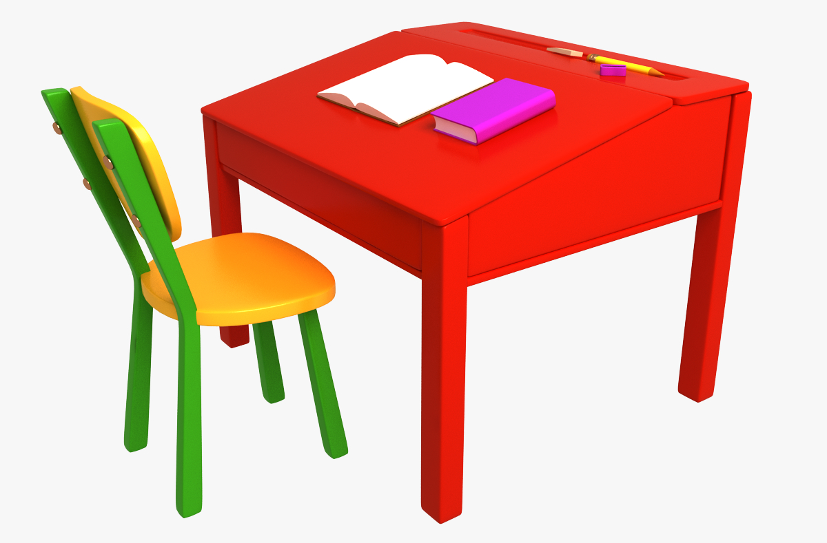
It’s a red desk.

Slide 8

Let’s talk
Notes:
Goal:
- Pupils will be able to introduce the things, using It’s a red _____.
Step 1: Point and say
Time limit: 3 mins
- Pupils open to the Let’s talk! part.
- Pupils point to the pictures and say using the structure It’s a red _____.

Slide 9



Notes:
Step 2: Practice
Game: Throw the ball
Time limit: 8 mins
- Teacher shows game slides or draws on the board.
- Teacher holds up a flashcard, pupils have to say It’s a red _____. If correct, they can throw a sticky ball to get stars.
Notes:
+ 1-5 stars: Pupils get star for their team.
+ Bomb: Lose a star.
+ Gun: Pupils can choose a team and say Shoot!. That team will lose a star.
+ Tornado: Change stars with the other teams.

Slide 10
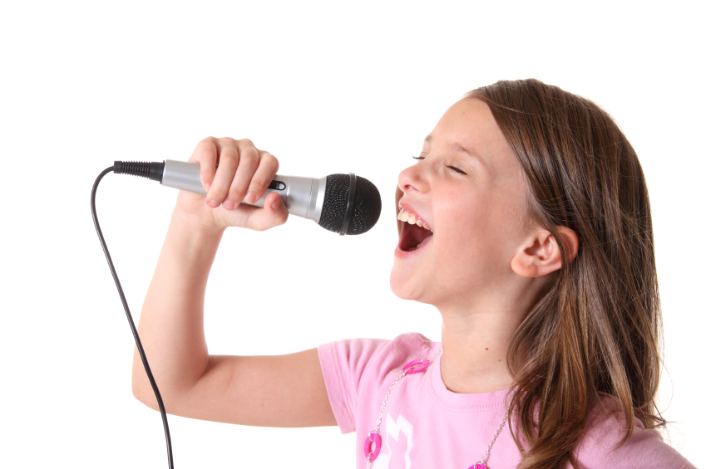


Let’s sing
Notes:
Goal:
- Pupils will be able to sing a song focusing on the main structures I have _____, He has _____ and It’s a red _____.
Step 1: Getting to know the song
Time limit: 4 mins
- Teacher and pupils read the song lyrics together.
- Teacher plays the audio.
1st time: Pupils only listen
2nd time: Pupils listen and sing.
Step 2: Sing and do
Time limit: 5 mins
Teacher plays the audio, shows pupils some actions to do when singing the song.
Step 3: Quick check
Time limit: 4 mins
Pupils sing and do in teams. Better team gets more stars.

Slide 11
Further activity
Notes:
Goal: Pupils are able to use the structure and vocabulary to write new lyrics for the song.
- Teacher divides pupils into small teams (4-5 pupils/ team)
- Pupils create new lyrics for the song using words and structure I have a_____, It’s a red_____.
- Teacher may have pupils perform the new song.

Slide 12
Goodbye
Notes:
- Teacher shows the vocabulary of the lesson on slide.
- Pupils say goodbye.

Slide 13
Goodbye

Slide 14
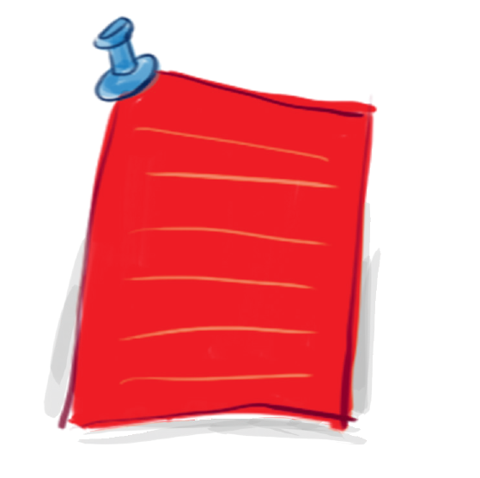
Goodbye

Slide 15
Goodbye

